Slide 1
Physics 320 Computational Physics Fall 2024
SLC 132
MW 1-2pm

Slide 2
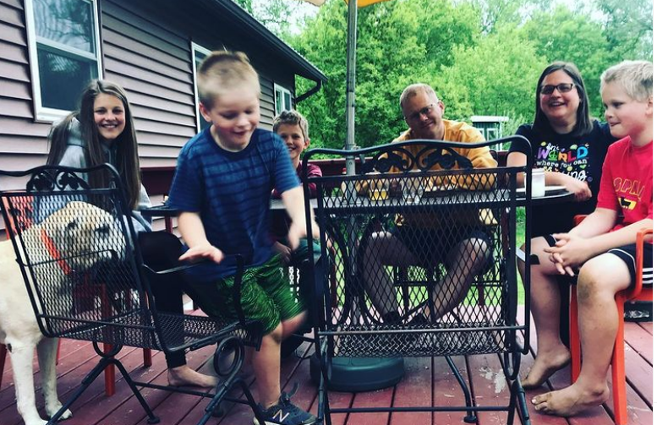

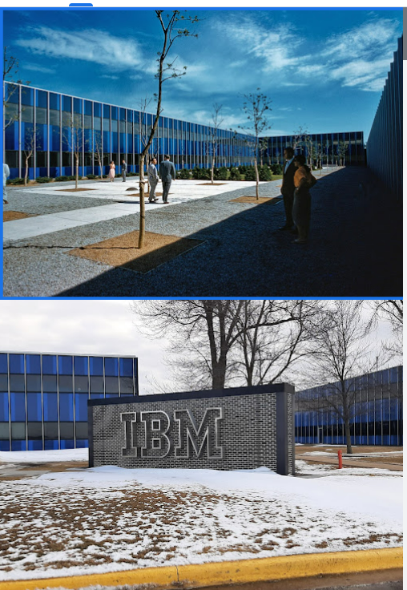

Who is Nathan Moore? (Nathan or Doctor or Professor, not Mister)

Slide 3
Computational Physics huh – does Nathan know anything about that?
https://arxiv.org/search/?searchtype=author&query=Moore%2C+N+T

Slide 4
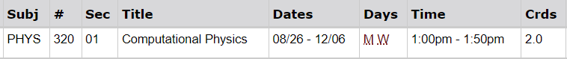
Bathrooms, pop machines, bananas
1-2pm is a LONG time to:
Sit and listen
Have to go to the bathroom
Suppress the urge to be thirsty
Think about how you missed lunch!

Slide 5

We're going to make it through!
Notes:
https://www.facebook.com/photo?fbid=10222822029154262&set=a.1254419435571 Tamura Lomax via Dr. J. Anderson, WSU

Slide 6
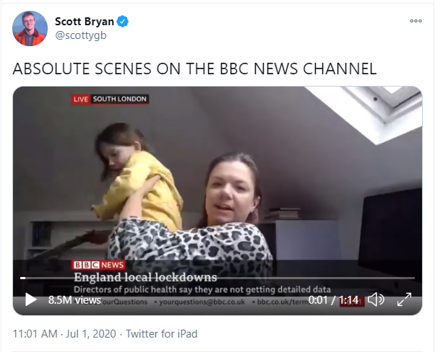
We're all human.
Notes:
https://twitter.com/scottygb/status/1278358093710217216

Slide 7
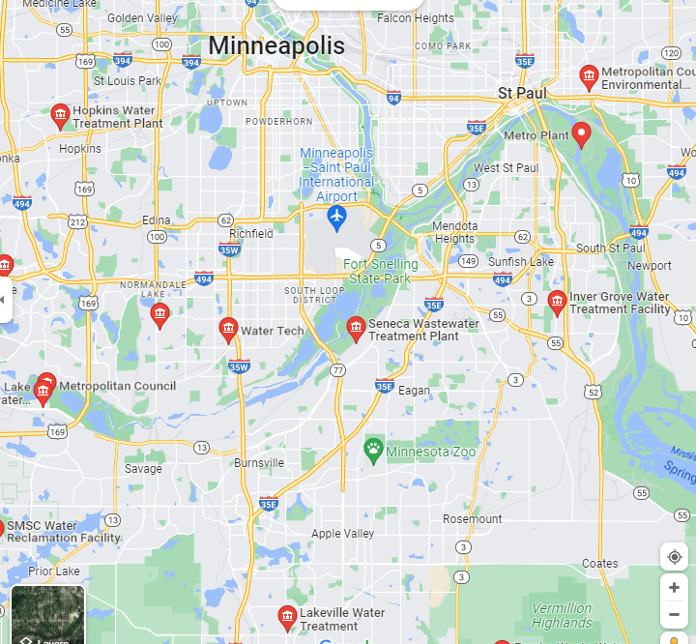


How do you measure how effective your vaccination campaign has been if nobody wants to admit getting a (polio, measles, etc) vaccine from the white western doctors?
Notes:
Covid RNA shows up in poop about a week before a rapid test shows that you’re covid positive! Everyone poops, but not everyone takes a covid test and reports the result.

Slide 8
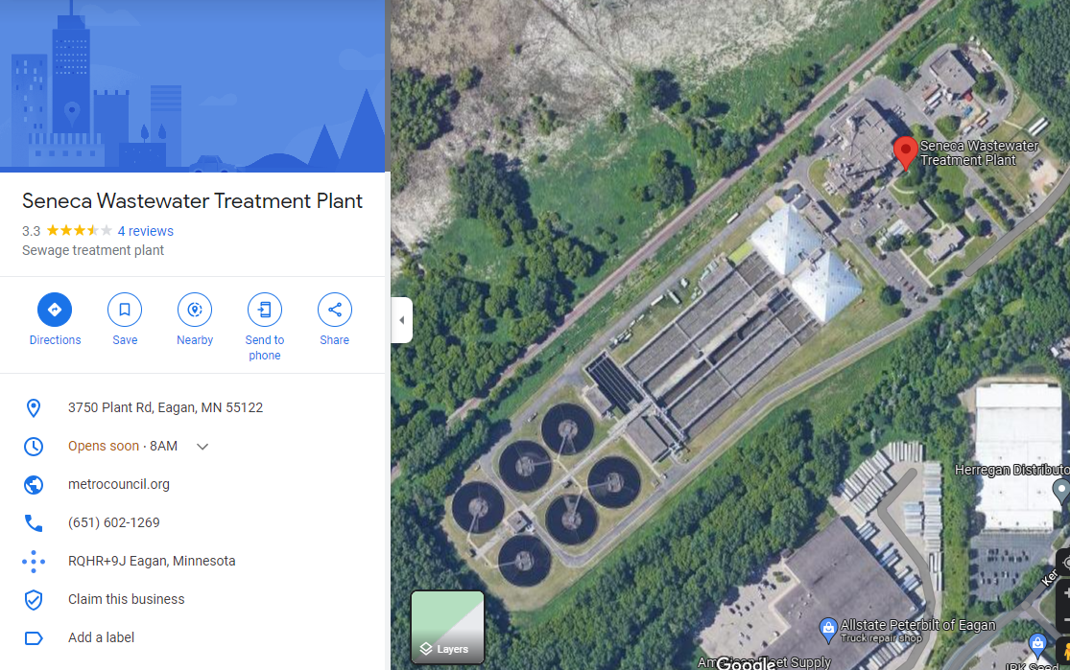

Slide 9
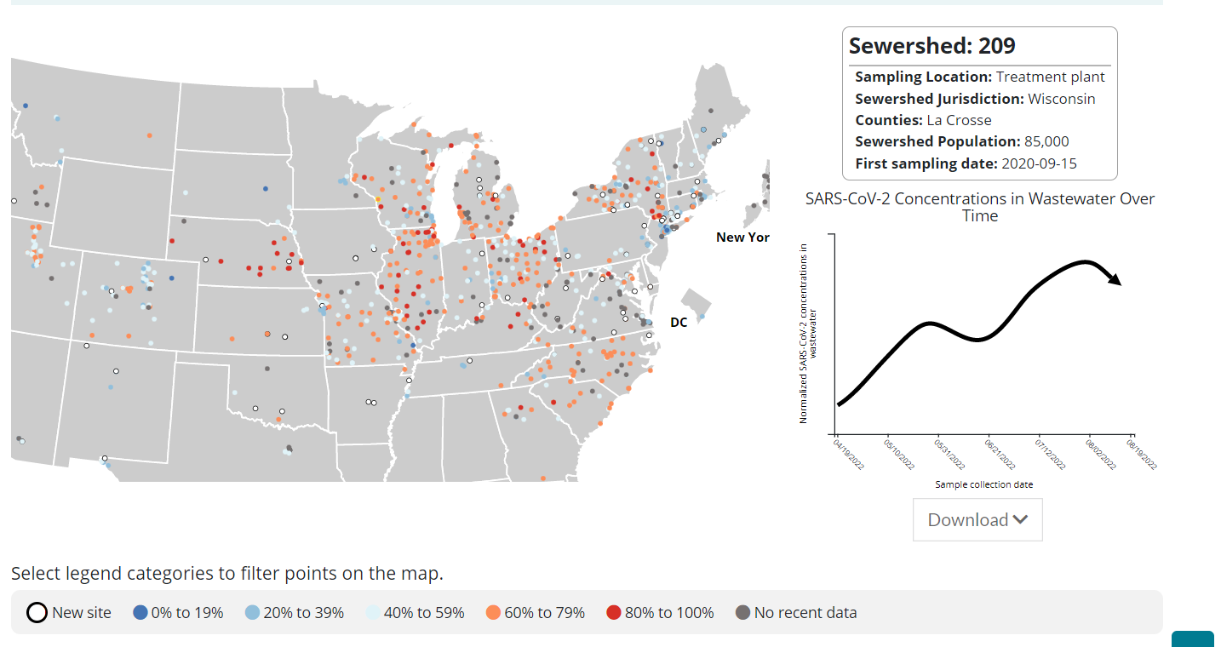
https://covid.cdc.gov/covid-data-tracker/#wastewater-surveillance
Notes:
https://covid.cdc.gov/covid-data-tracker/#wastewater-surveillance

Slide 10
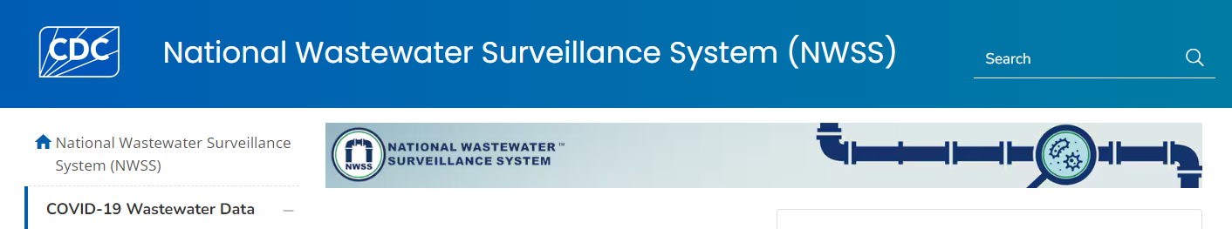
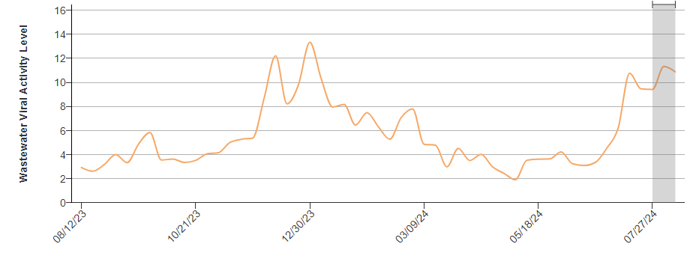

Slide 11
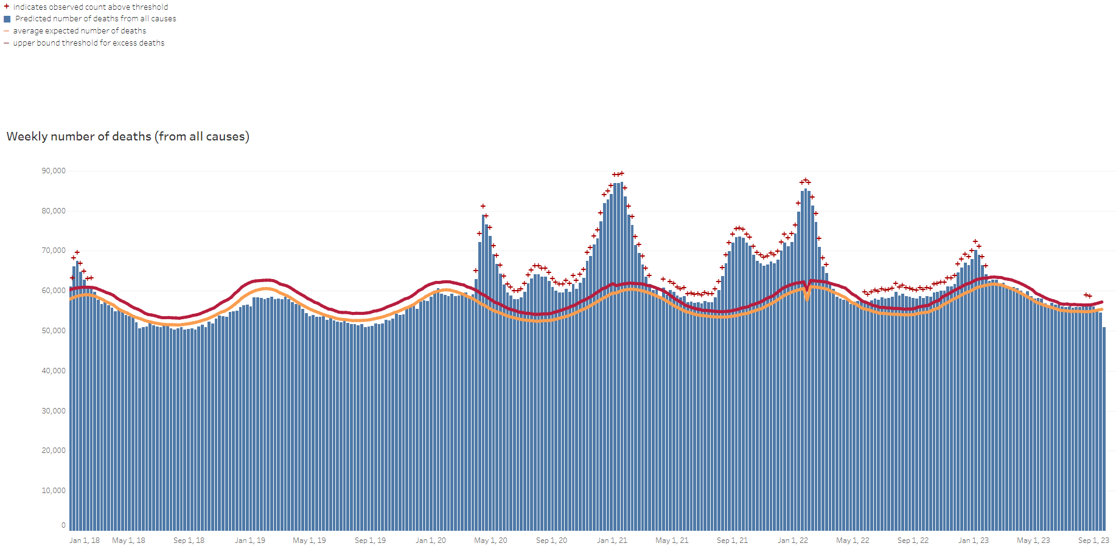
Excess Deaths Associated with COVID-19 (cdc.gov)
Notes:
https://www.cdc.gov/nchs/nvss/vsrr/covid19/excess_deaths.htm

Slide 12
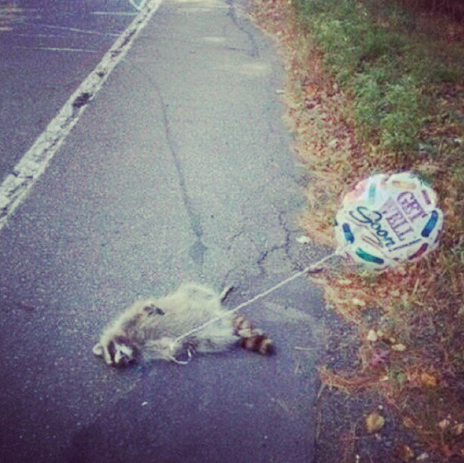
Great...
Get vaccinated
(maybe) Wear a mask over your nose
Get enough sleep
Get enough exercise
Eat vegetables
If you are covid positive, let me know (for your classwork)
If you are covid positive, let me know (for others!)
“Eventually, covid will be like catching a cold”
MD at Winona Health in charge of covid tests
I TRUST YOU. I DON’T NEED A DOCTOR’S NOTE!

Slide 13




“Whew” or “Pfew”
For serious, which is it?

Slide 14

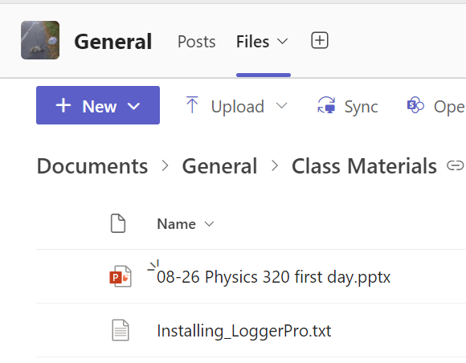
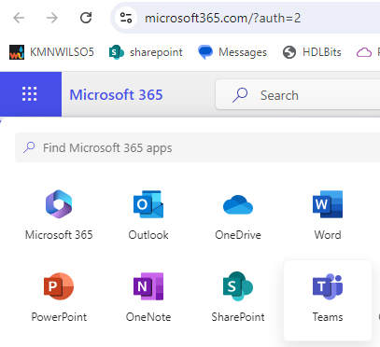



Course Files are in a Team, maybe also D2L

Slide 15
What are we going to do (for points)?
Programming assignments
Reading/thinking/mathing assignments

Slide 16
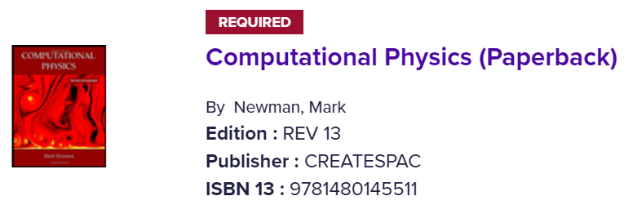

Do I have to buy a book?
Yes, you should buy two books (can be shared!)
There are lots of good computational physics books in Python. This is an inexpensive one that’s not written by someone I know to be a pompous a-hole.
This book is not about murder.

Slide 17
Grades and assignments
Turn stuff in and you’ll do fine in the class.
Do your own work, but feel free to talk to others as you work.

Slide 18
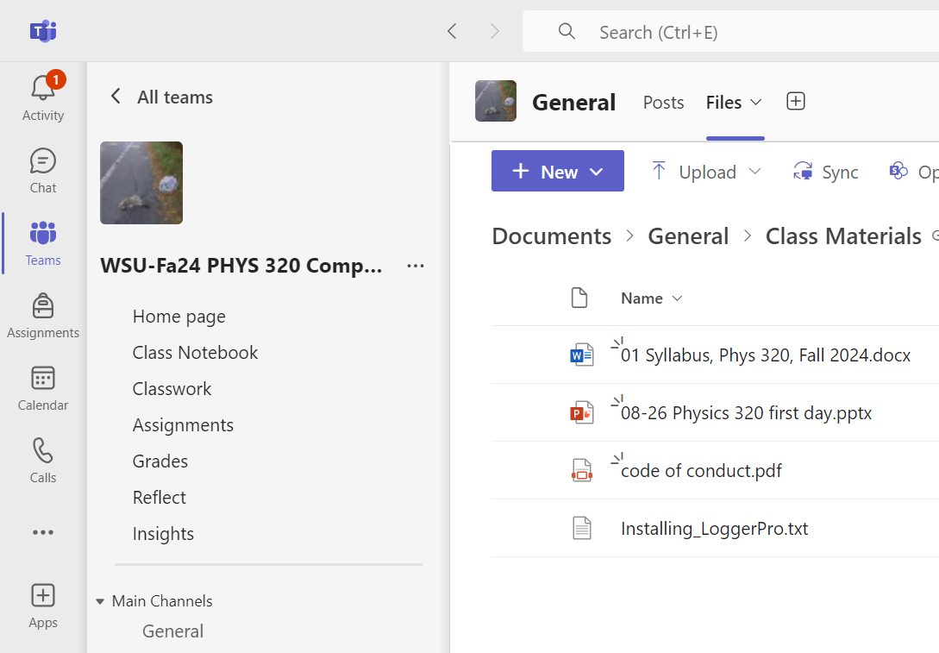
Try opening the Syllabus (via Teams)

Slide 19
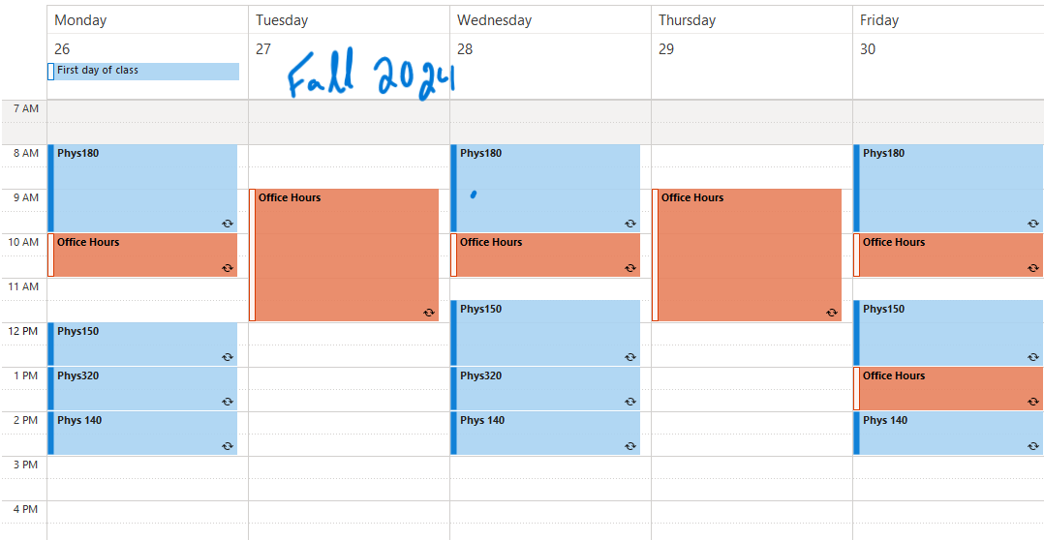

Slide 21
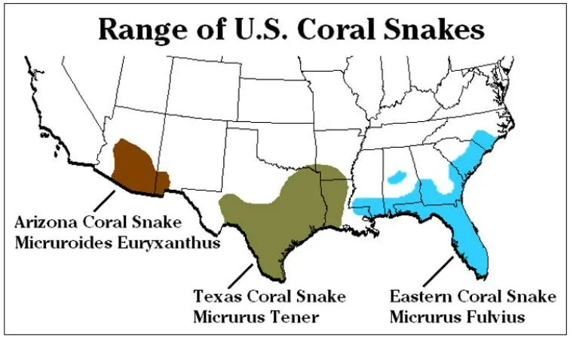
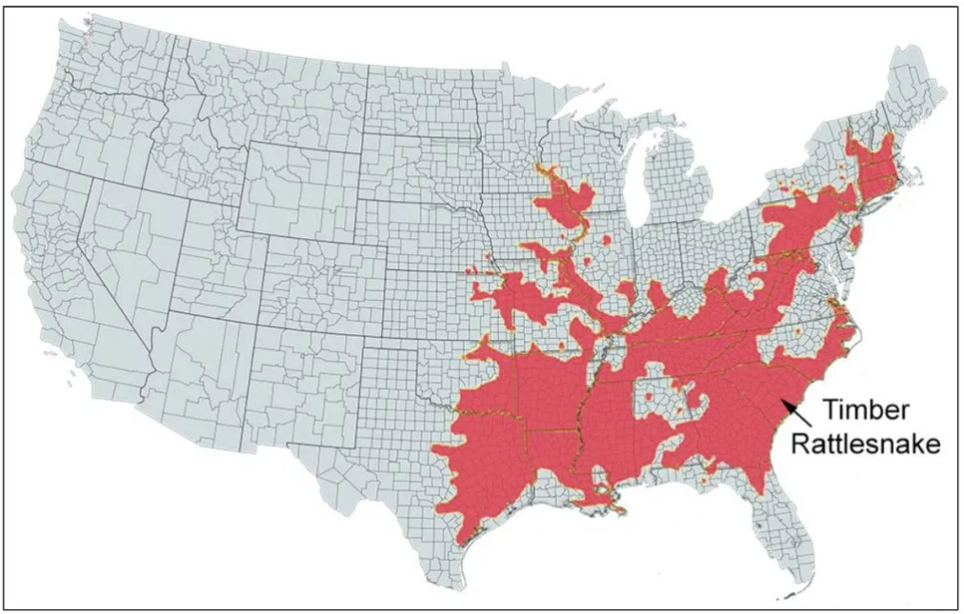
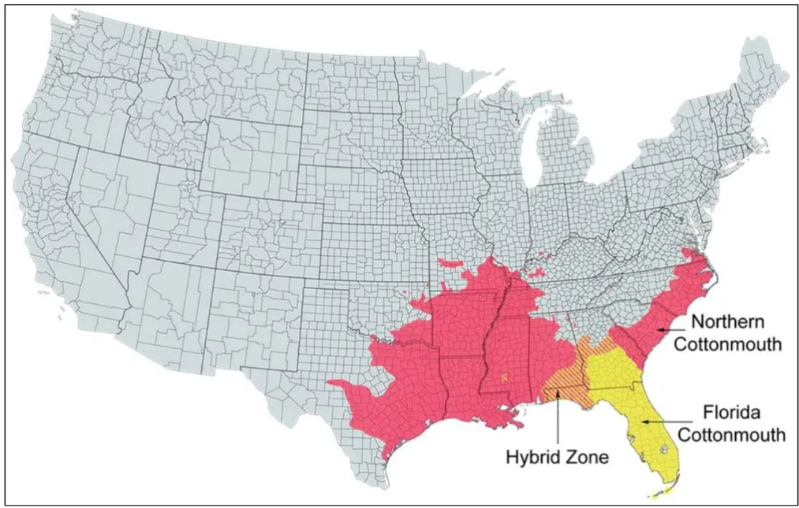
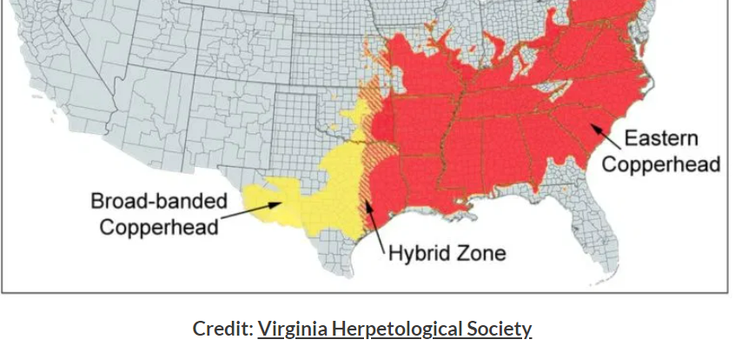
Notes:
https://birdwatchinghq.com/venomous-snakes-in-florida/

Slide 22
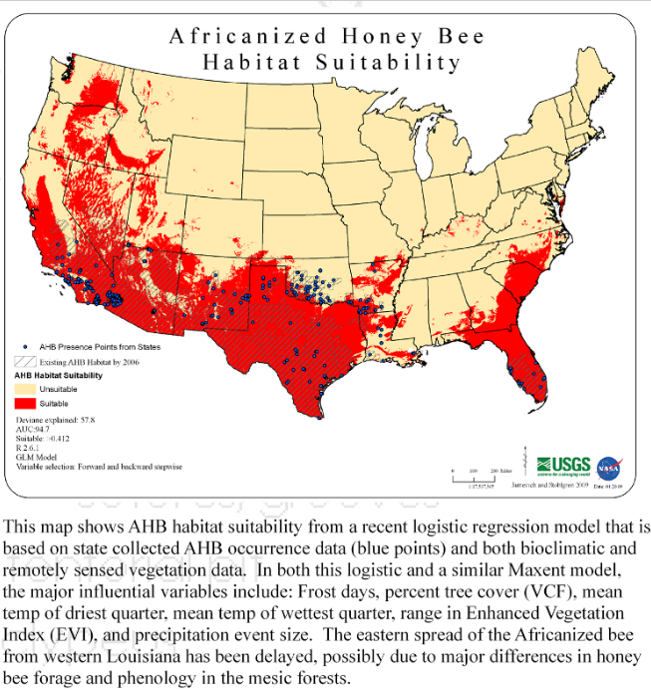
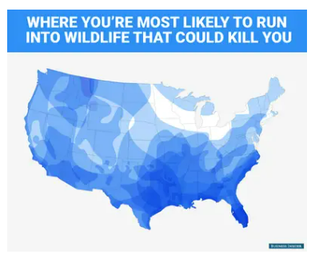
Notes:
https://www.businessinsider.com/a-us-map-of-wildlife-that-could-kill-you-2016-6
https://www.adkinsbeeremoval.com/africanized-honey-bee.php

Slide 23
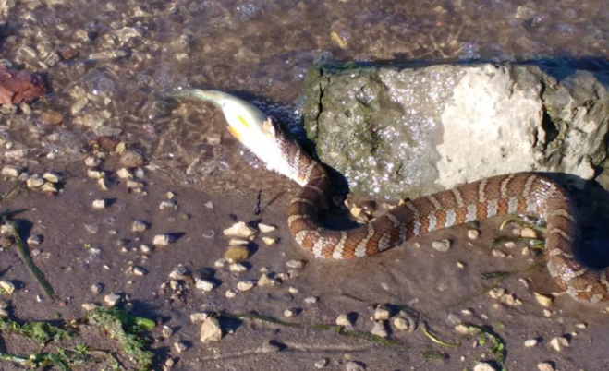
Once, I realized there was a snake, eating a fish, 3 feet from my legs. It was different from the zoo in the same way that doing Algebra in Math is different that doing Algebra in Physics. Things in the wild are a little scarier, because it seems like there are no rules, no fence, and no safety rope. To me, one of the special things about Physics 221-222 is that you get to do Calculus “in the wild.”

Slide 24
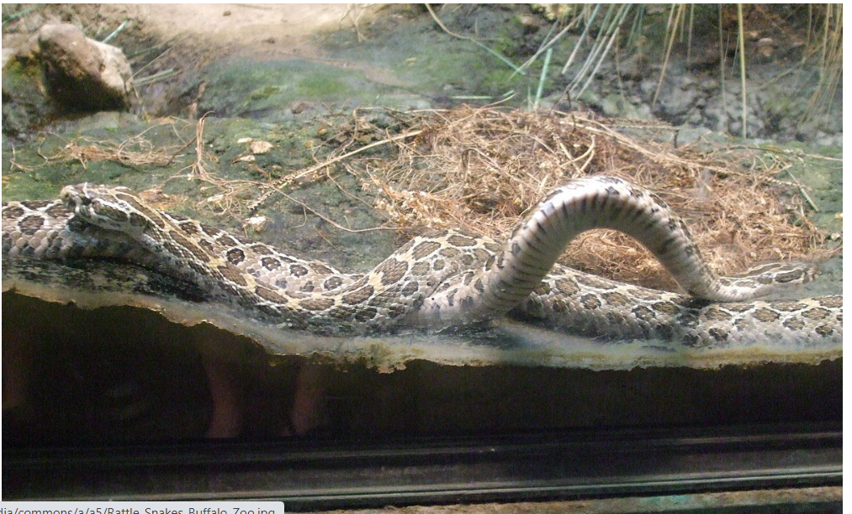

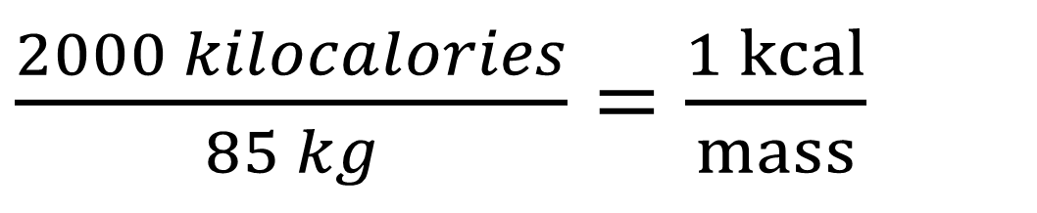
$$\frac{2}{3}=\frac{9}{x}$$
$\frac{2000 kilocalories}{85 kg}=\frac{1 kcal}{mass}$
The same, but maybe they don’t feel the same.
Notes:
https://commons.wikimedia.org/wiki/File:Rattle_Snakes_Buffalo_Zoo.jpg

Slide 25

Mental and Physical Health is Paramount
If you need an accommodation in class, please talk with me as soon as possible.
Access Services
College can be very stressful or lead to anxiety and depression.
Counselling and Wellness Services
Get enough sleep
Eat well and stay active
Get outside
Keep a schedule and come to class!

Slide 27
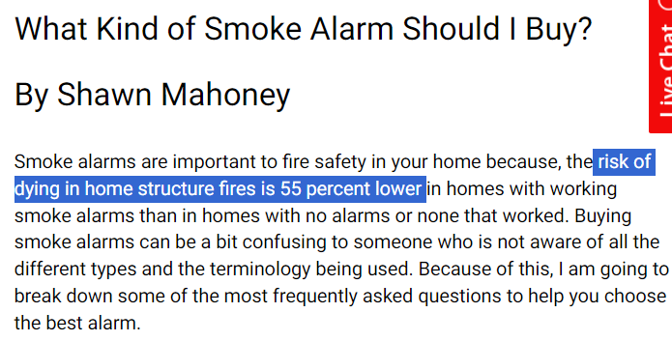
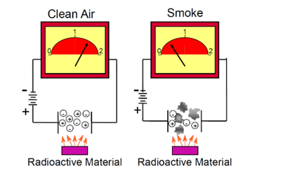
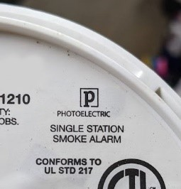
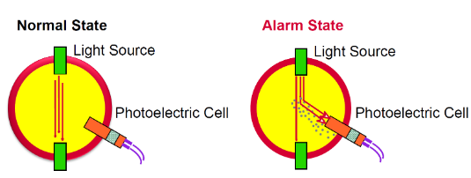
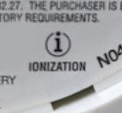
Smoke detectors
Notes:
https://www.nfpa.org/news-blogs-and-articles/blogs/2023/03/06/what-kind-of-smoke-alarm-smoke-detector-should-i-buy
https://en.wikipedia.org/wiki/Smoke_detector

Slide 28
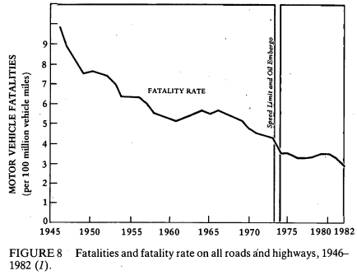
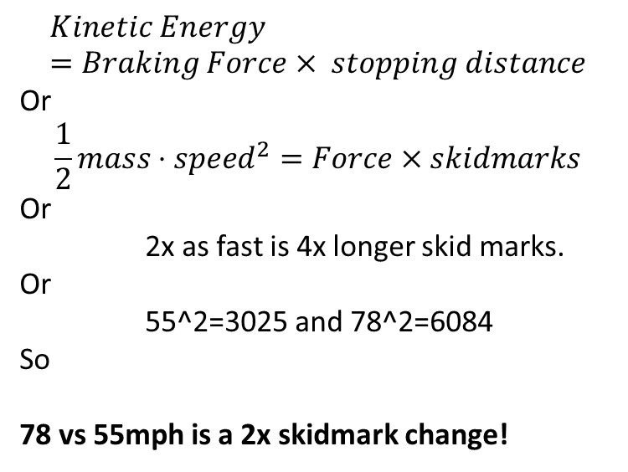
Speeding
In 2022, 12,151 deaths (29% of all motor vehicle fatalities) occurred in speed-related crashes.
$$Kinetic Energy =Braking Force× stopping distance$$
Or
$$\frac{1}{2}mass⋅speed^{2}=Force×skidmarks$$
Or
2x as fast is 4x longer skid marks.
Or
55^2=3025 and 78^2=6084
So
78 vs 55mph is a 2x skidmark change!
Notes:
https://www.iihs.org/topics/speed

Slide 29
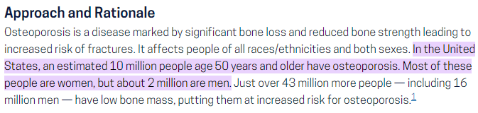
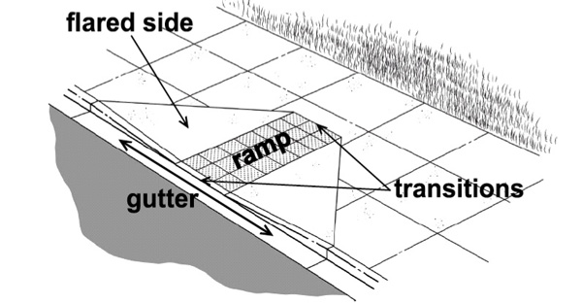
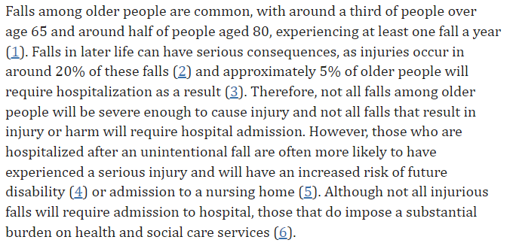

Sidewalks
Notes:
https://health.gov/healthypeople/about/workgroups/osteoporosis-workgroup#:~:text=In%20the%20United%20States%2C%20an,about%202%20million%20are%20men.
https://www.ncbi.nlm.nih.gov/pmc/articles/PMC8427733/
https://archive.ada.gov/pcatoolkit/chap6toolkit.htm

Slide 30
What other safety guardrails do we build into society?

Slide 31
Trigger Warning, data about sexual assault

Slide 32
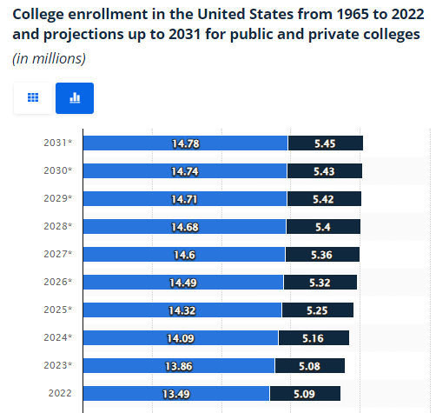
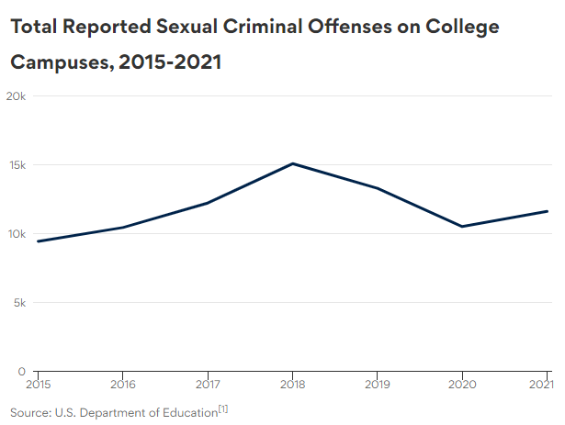

Notes:
https://www.bestcolleges.com/research/campus-sexual-assault-statistics/
https://www.statista.com/statistics/183995/us-college-enrollment-and-projections-in-public-and-private-institutions/

Slide 33





Notes:
Gg

Slide 34
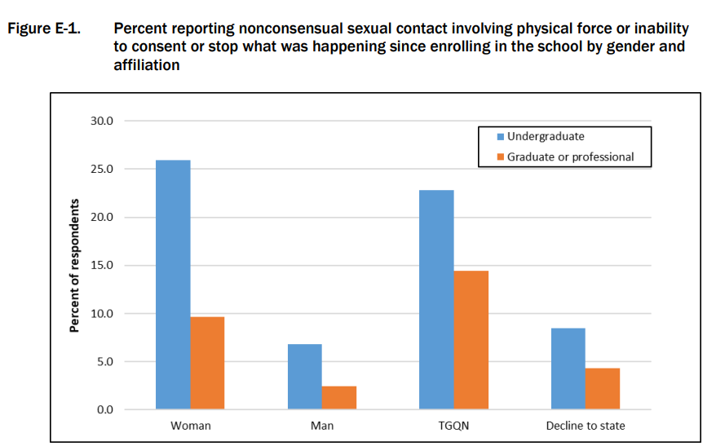
Reference 2 is the NAU report https://rainn.org/statistics/campus-sexual-violence

Slide 35
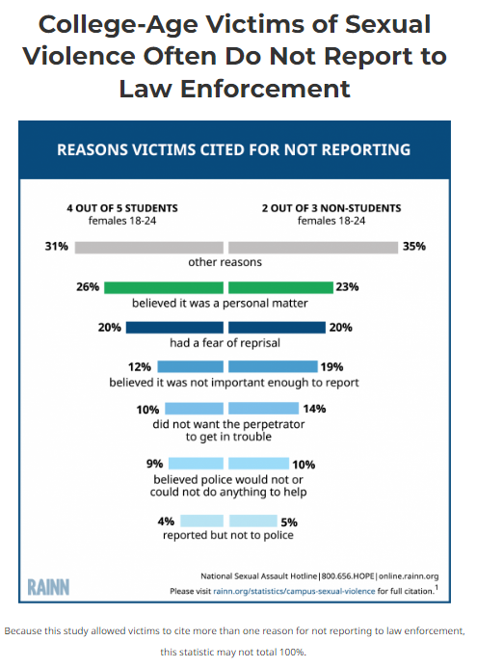
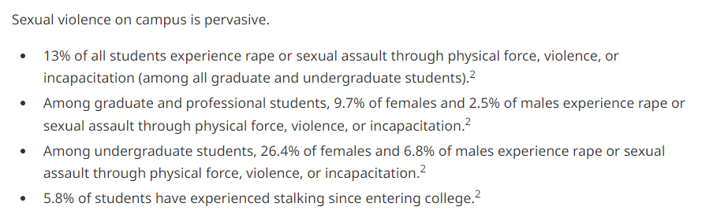


Reported events << Actual events
https://rainn.org/statistics/campus-sexual-violence
Notes:
https://rainn.org/statistics/campus-sexual-violence#:~:text=Sexual%20violence%20on%20campus%20is,all%20graduate%20and%20undergraduate%20students).

Slide 36
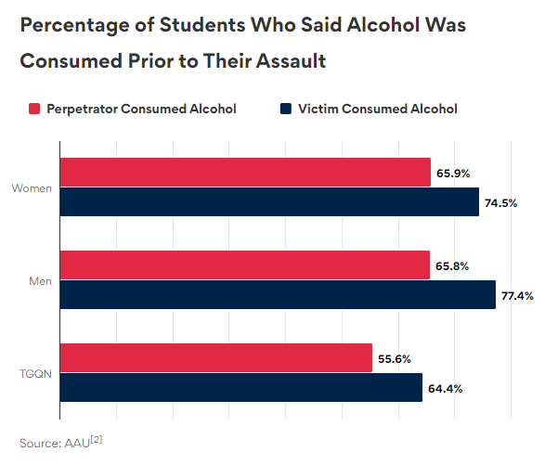

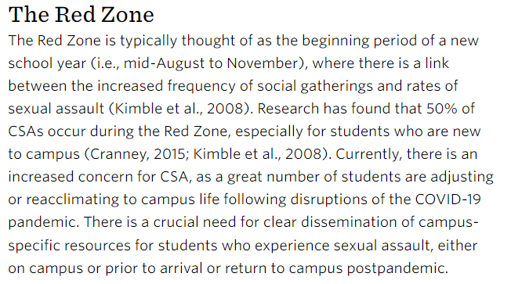
https://www.apa.org/apags/resources/campus-sexual-assault-fact-sheet
Fall Semester is the time to think about this!

Slide 37
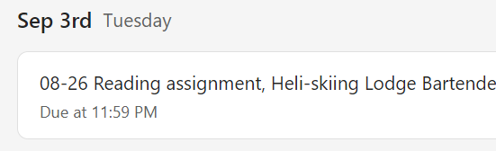
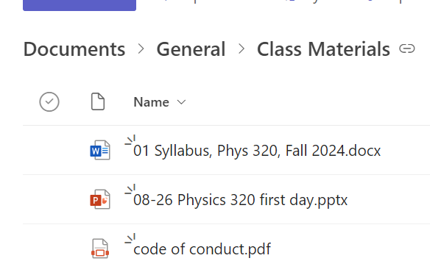
Reading/Writing assignment: What safety guardrails would reduce sexual assault? My feeble effort: code of conduct

Slide 38
To-do list (for Wednesday)
Buy the books (maybe to share?)
Read the Heli-Skiing Lodge article and respond to the assignment.

